Slide 1
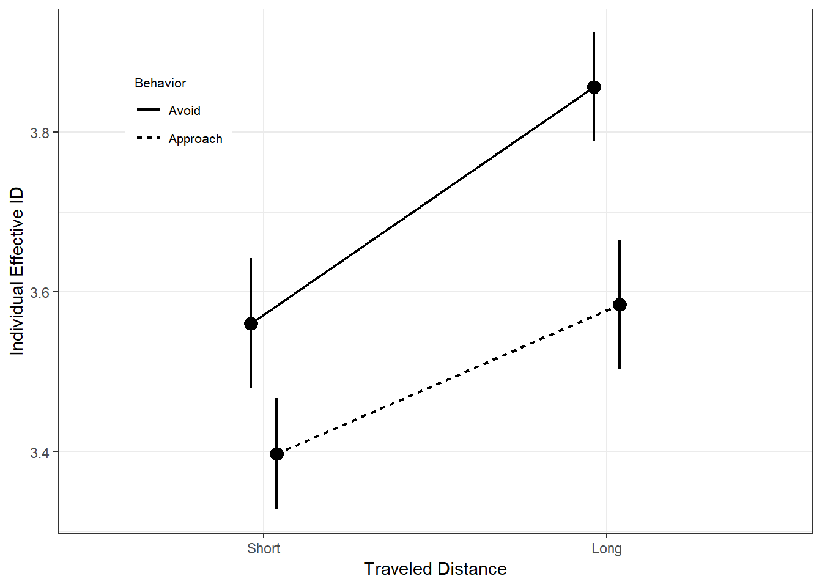
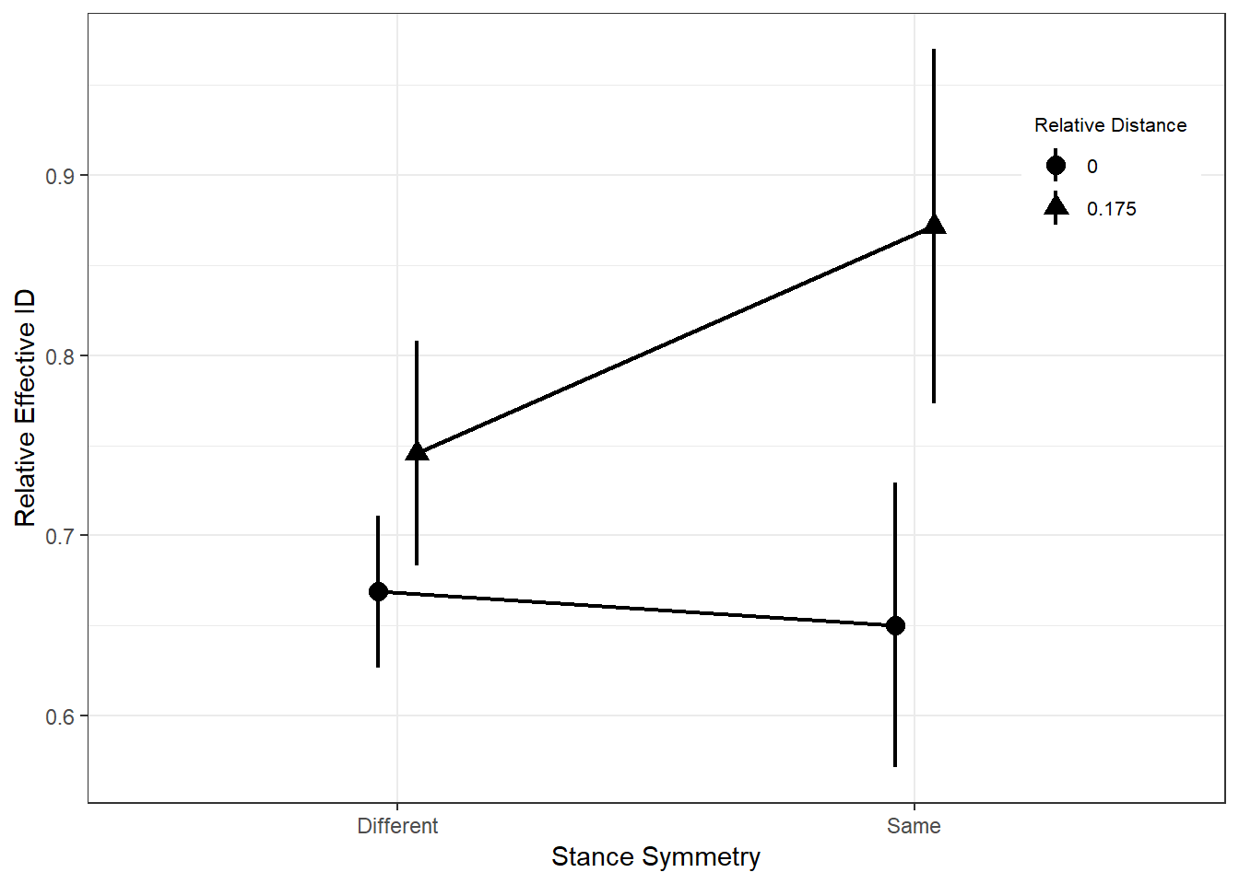
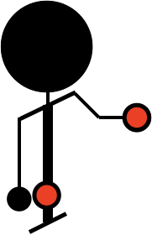
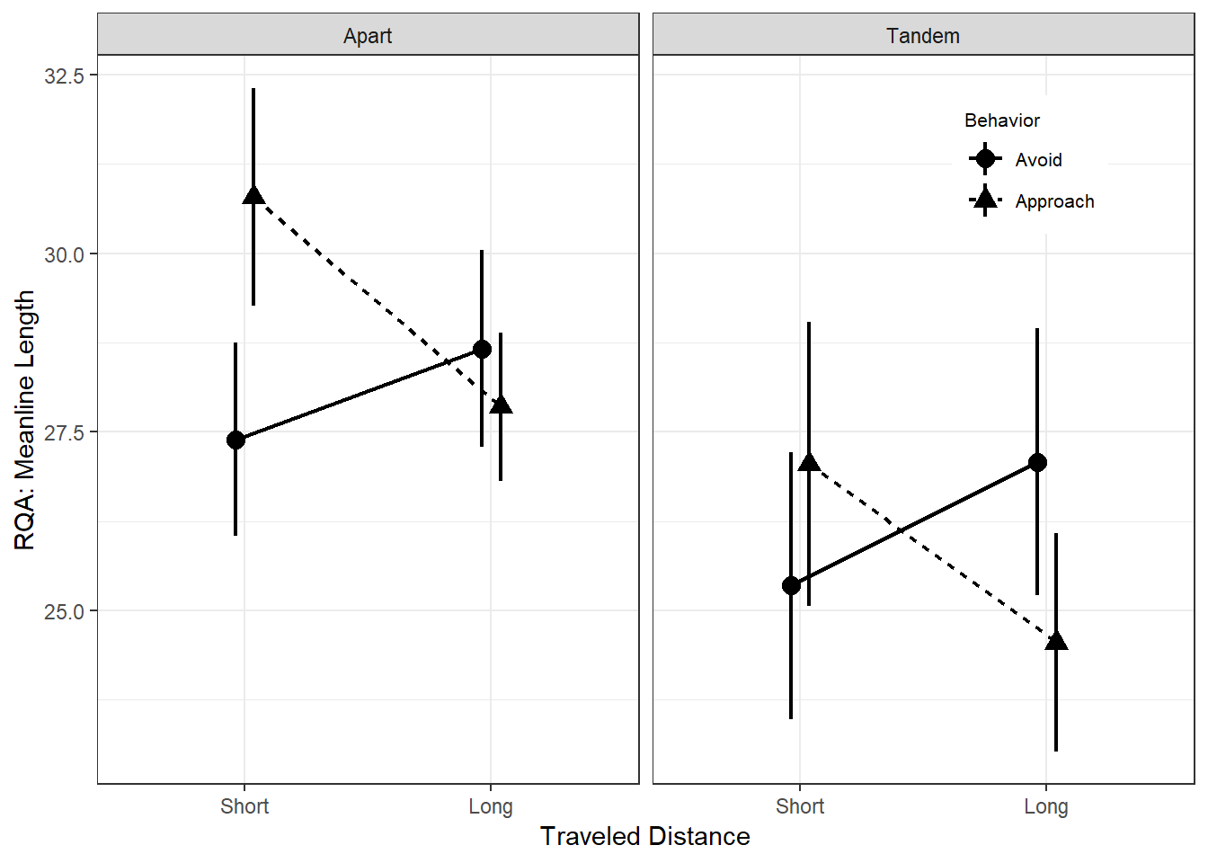
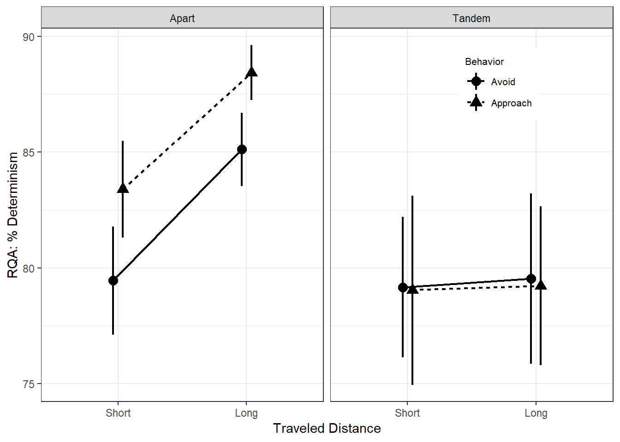
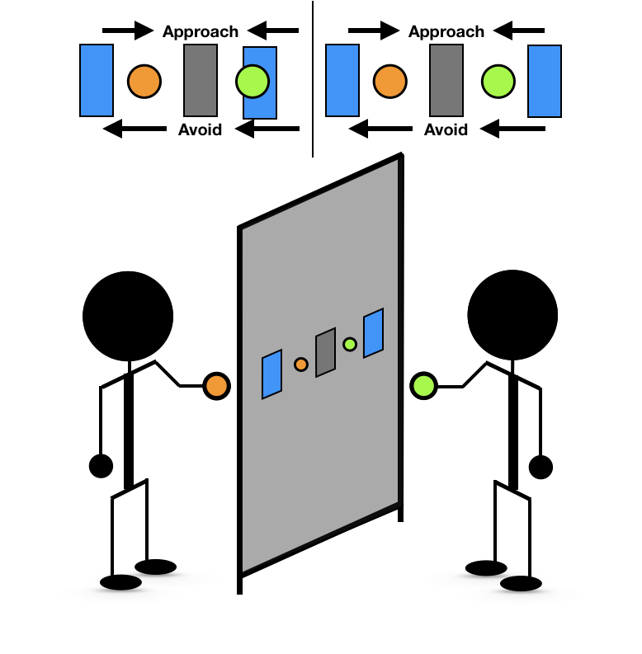
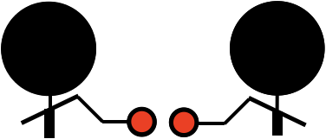
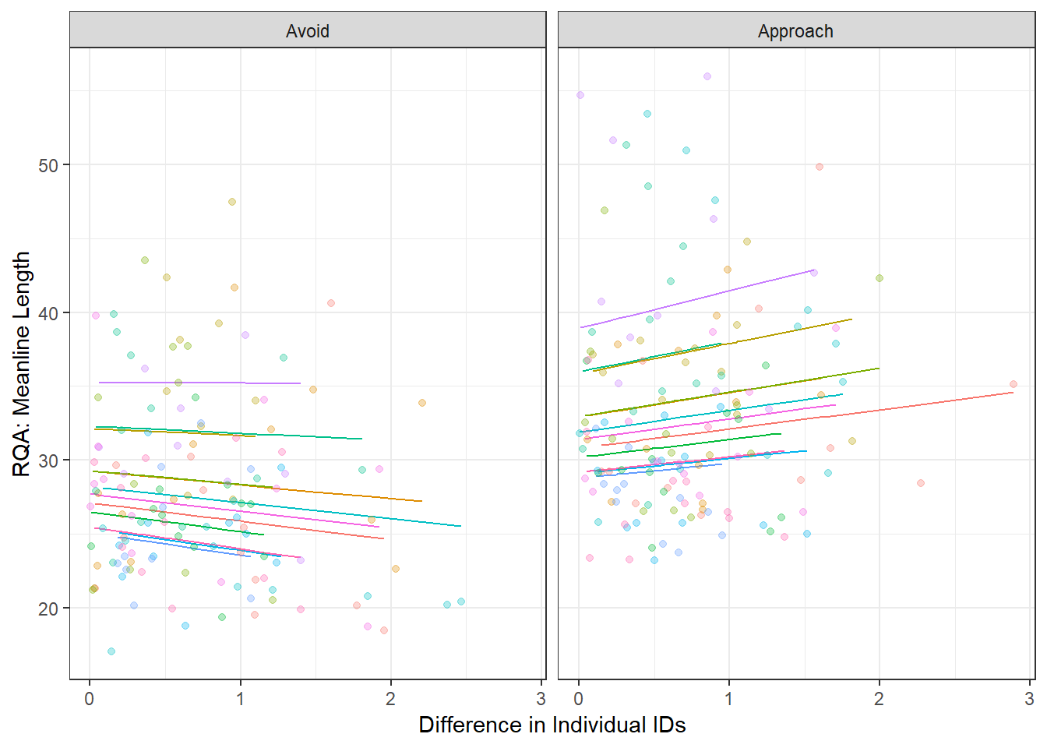
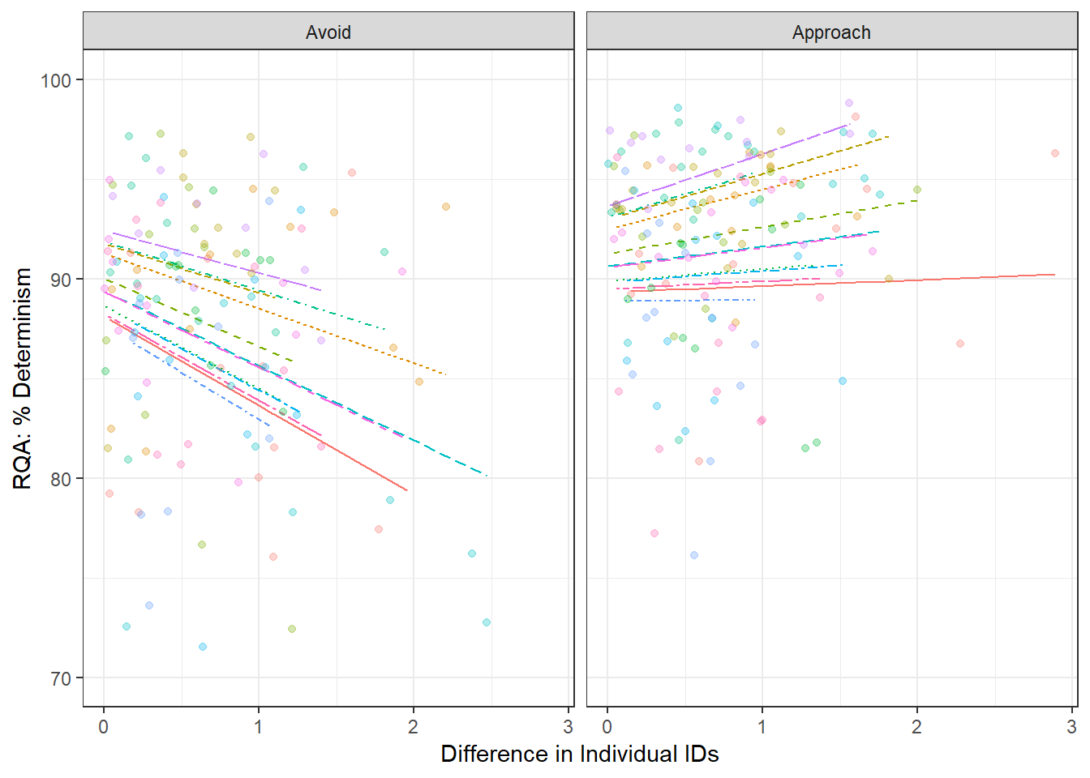

Differences in task difficulty affects the dynamics of coordination.
What Fitts: Asymmetrical Task Demands Influence Joint Action Outcomes
Sierra F. Corbin, Maurice Lamb, & Tehran Davis
Center for Cognition, Action, & Perception, Department of Psychology, University of Cincinnati
Background
Successful joint action results from actors effectively coordinating their behavior with one another to meet their shared task demands while also managing individual task demands.
Asymmetries in individual task demands have been shown to affect the dynamics of both intrapersonal and interpersonal coordination during joint action [1].
Further, differences in attractor strength result in marked by differences in movement variability when comparing in-phase and anti-phase coordination patterns; [2] approach versus avoid conditions.
Using an intrapersonal Fitts’ Law task, [3] concluded that manipulation of indices of difficulty (IDs), or the value that represents the overall task difficulty based on target distance and width and the resulting variability when hitting the targets, may demand more complex modifications than simply changing a single parameter related to the ID.
The current project investigated the relationship between difficulty in task demands at the individual and shared levels and how they correspond to the resulting joint action dynamics.
Effective ID: Personal & Relative
Individual and relative difficulty (as measured by Effective ID) change as a function of the task asymmetries
Individual ID: 2 (Stance) x 2 (Distance Traveled) x 2 (Behavior) RMA:
Behavior: F(1, 23) = 18.76, pes = .45, p < .001. (Phase)
Distance Traveled: F(1, 23) = 7.28, pes = .24, p = .01. (Fitts’ Law)
Relative ID: 2 (Stance Symmetry) x 2 (Relative Distance) x 2 (Behavior) RMA:
Relative Distance: F(1, 11) = 12.11, pes = .52, p < .01.
Stance Symmetry x Relative Distance: F(1, 11) = 3.68, pes = .25, p = .08.
Intrapersonal Results
RQA measures of intrapersonal Hand-Torso coupling change as a function of behavior (phase) and individual effective ID
RQA: Meanline length via 2 (Stance) x 2 (Distance Traveled) x 2 (Behavior) RMA:
Stance: F(1, 23) = 4.58, pes = .17, p = .04.
Behavior x Distance Traveled: F(1, 23) = 3.89, pes = .14, p = .06.
RQA: % Determinism via 2 (Stance) x 2 (Distance Traveled) x 2 (Behavior) RMA:
Stance: F(1, 23) = 4.51, pes = .16, p = .04.
Stance x Behavior: F(1, 23) = 3.51, pes = .13, p = .07.
Task Asymmetries
Target distances
Posture demands
Approach v. avoid behavior
Interpersonal Results
RQA measures of CRP change as a function of behavior and difference in individual IDs
RQA: Meanline length via LMM:
Behavior: ß = 3.68, SE = 1.24, p = .003.
Behavior x Relative ID: ß = 2.56, SE = 1.37, p = .06.
RQA: % Determinism via LMM:
Relative ID: ß = -3.55, SE = 0.98, p < .001.
Behavior x Relative ID: ß = 4.76, SE = 1.31, p = .06.
[1] Davis, T. J., Pinto, G. B., & Kiefer, A. W. (2017). The stance leads the dance: the emergence of role in a joint supra-postural task. Frontiers in Psychology, 8, 718.
[2] Richardson, M. J., Schmidt, R. C., & Kay, B. A. (2007). Distinguishing the noise and attractor strength of coordinated limb movements using recurrence analysis. Biological Cybernetics, 96, 59-78.
[3] Huys, R., Knol, H., Sleimen-Malkoun, R., Temprado, J. J., & Jirsa, V. K. (2015). Does changing Fitts’ index of difficulty evoke transitions in movement dynamics? EPJ Nonlinear Biomedical Physics, 3, 8.
Take a picture to download extended analyses

